Slide 1
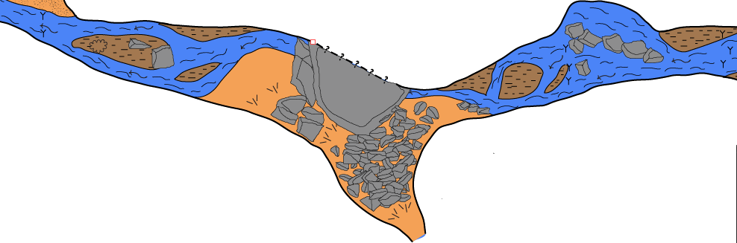
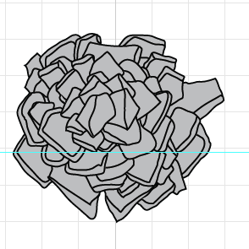
Adding Color to Maps in Illustrator
and
Getting your Rocks Filled !

Slide 2
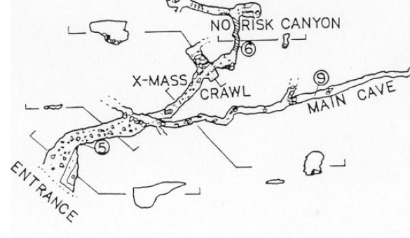
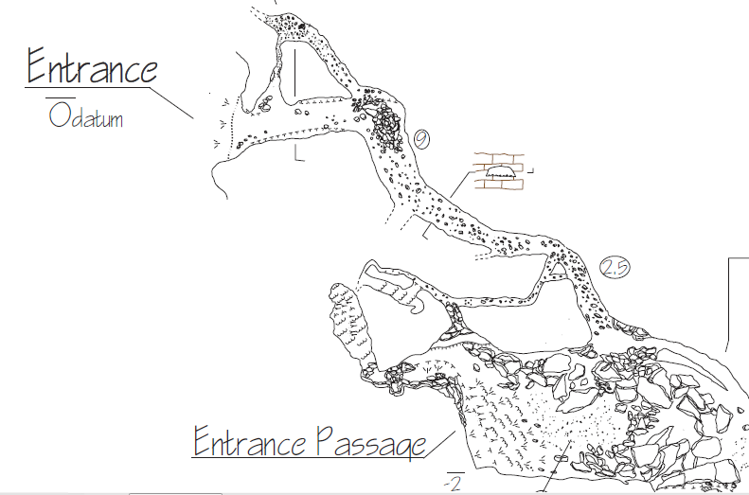
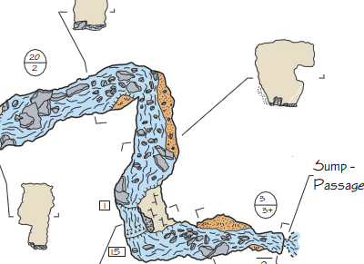
Cave Cartography has evolved over the years
We started with hand drafted and inked maps
In the past 15 years, computer drafted maps have become the standard
More recently, maps that use color to aid comprehension are rapidly becoming more and more common

Slide 3
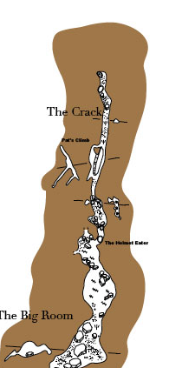
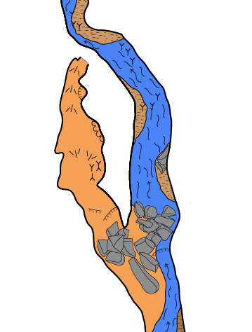
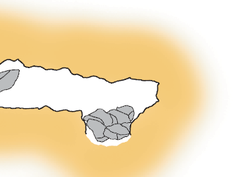
Sometimes we use color to highlight the cave itself
B. Kowallis
Sometimes we use color to inform about the characteristics of the cave
Sometimes we use color for both purposes

Slide 4
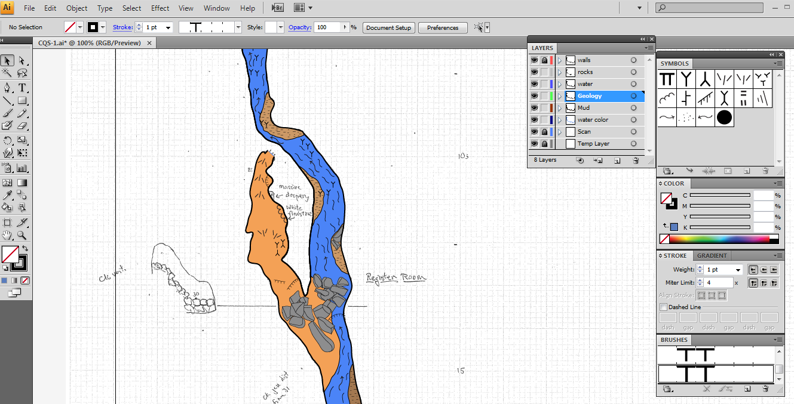
For all of these uses there are many techniques and tricks that we can use in Illustrator (or many other drawing programs) that help us add color to our maps

Slide 5
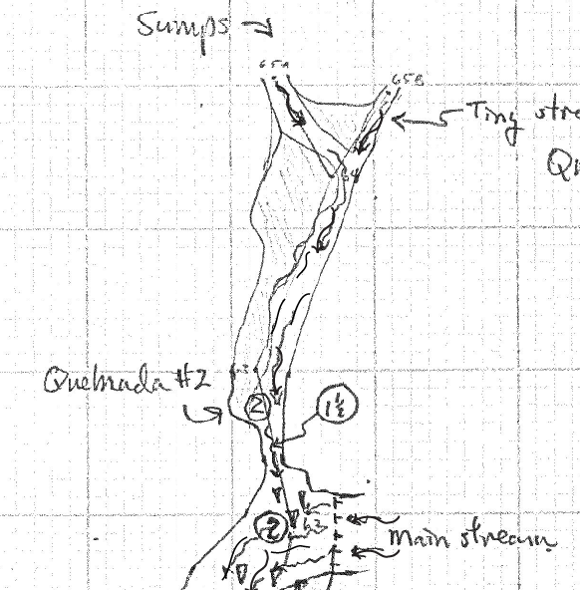
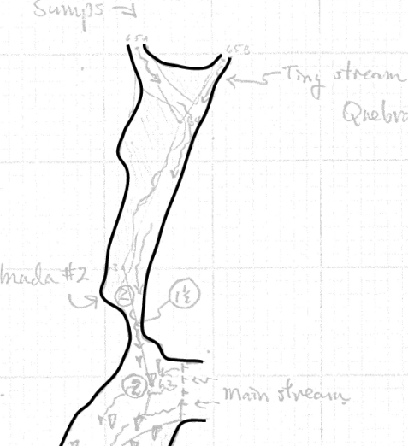
Filling Large Areas
Here is a section of a River Cave (R. Finch, Guatemala)
How do we add some color to designate water and mud fill?
First , walls are drawn in, as normal

Slide 6
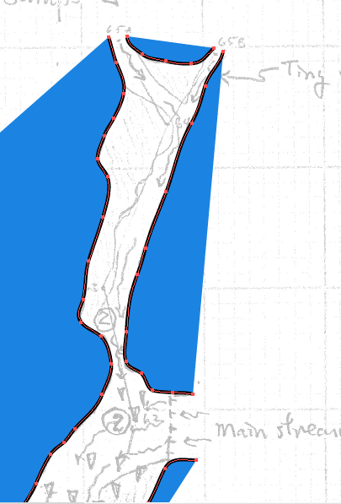
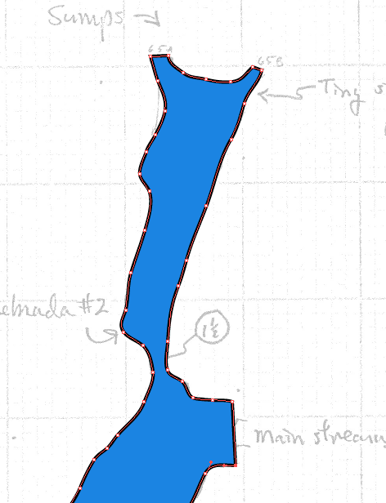
However, if I try to add a fill color, strange things happen. Color ends up OUTSIDE the passage
This is due to the fact that your line segments are not connected, because the passage beyond is not surveyed
We can make this work by connecting the line segments
But that leaves passage walls where we really don’t want them

Slide 7
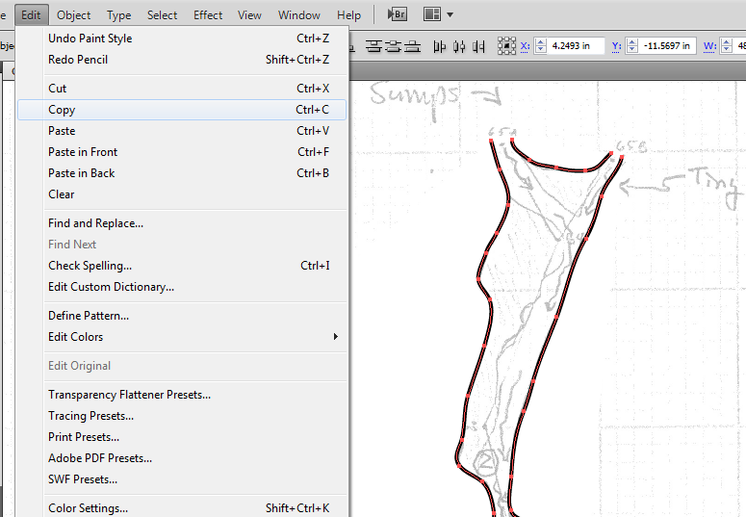
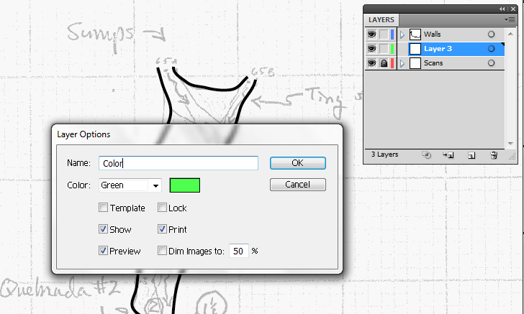
How to add color without walls!
1) Copy the walls that will enclose your color
2) Set up a new Layer – name it a color layer, like water color, for example

Slide 8
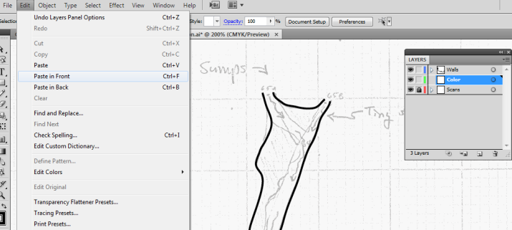
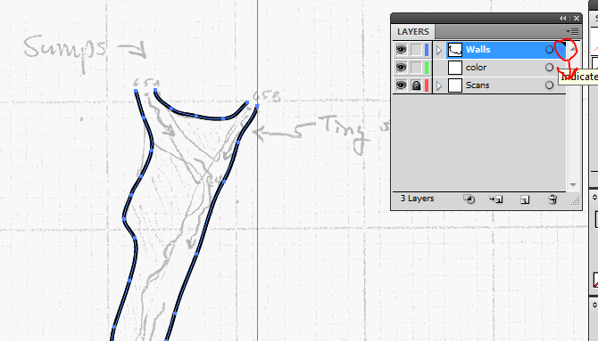
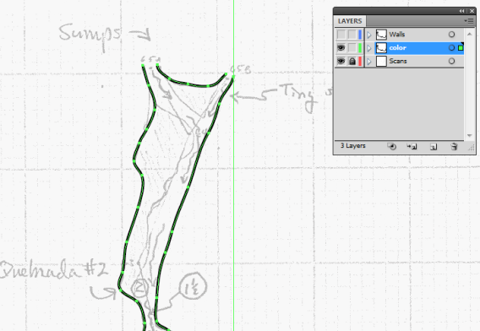
3) Use the paste in front function (in the edit menu). This will paste a copy of the walls in front of the current set of walls
4) The extra set of walls will be in the same layer. They need to be placed in the new layer. This can be done with the bulk move function in the layer menu
5) The new set of walls are in the new layer (water)

Slide 9
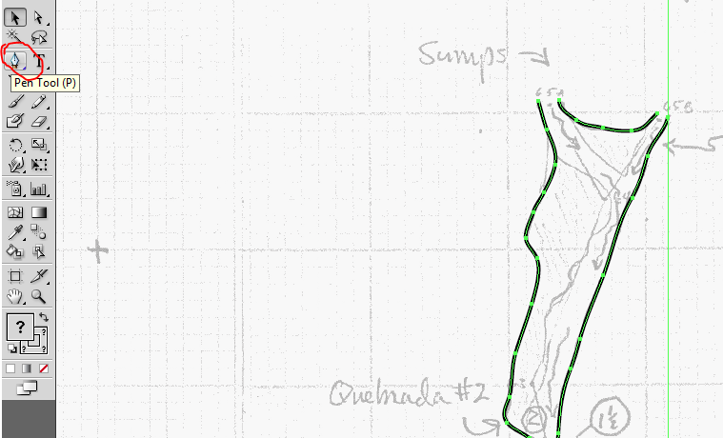
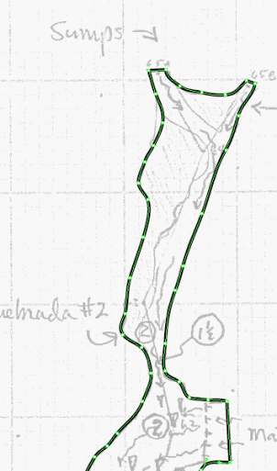
6) Now use the Pen tool, and connect all the line segments with section of line
7) Close all open sections of cave

Slide 10
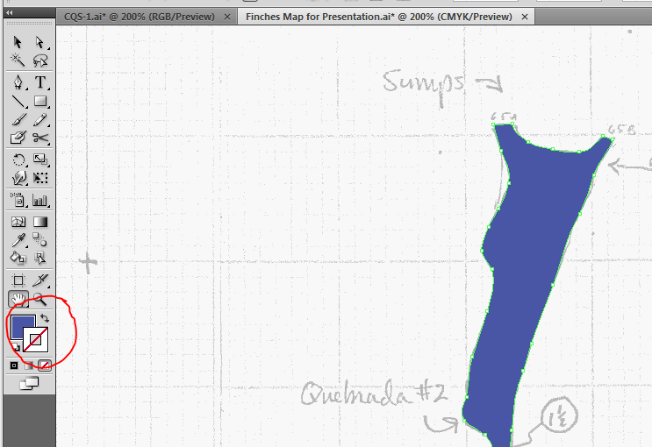
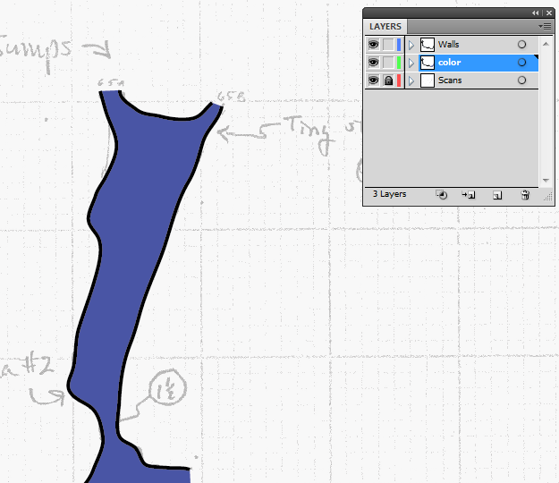
8) Using the Stroke and Fill command, add a water color, and set the stroke to none
9) Turn on the original walls, and the color will fill behind it without closing the passages that are open

Slide 11
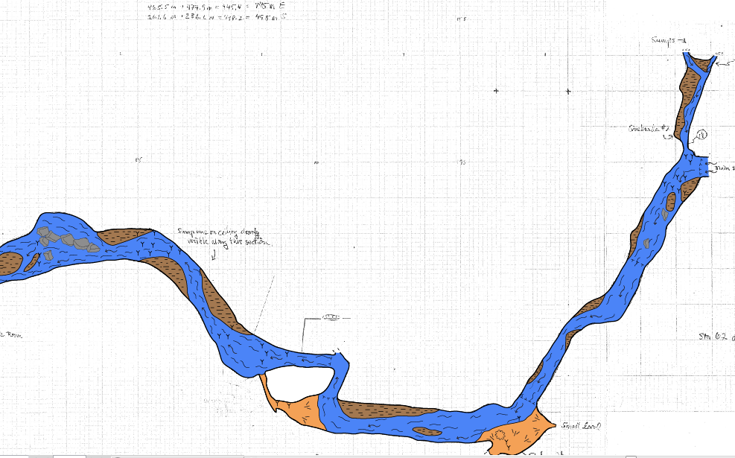
This can be used over large areas and used for several different areas and colors

Slide 12
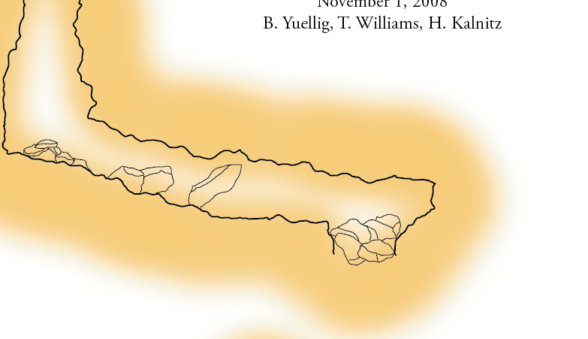
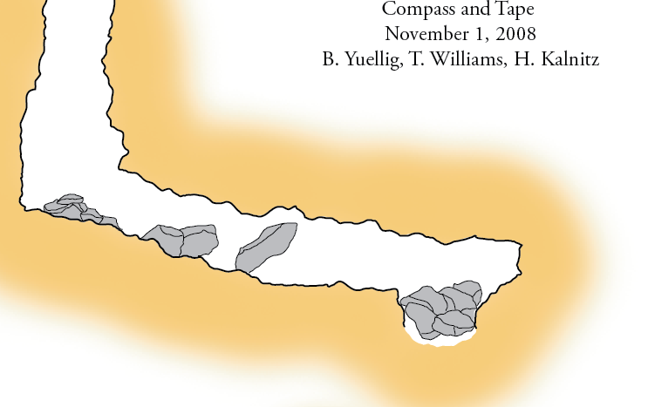
This can also be used to create a blank area inside passages to offset against outside color

Slide 13
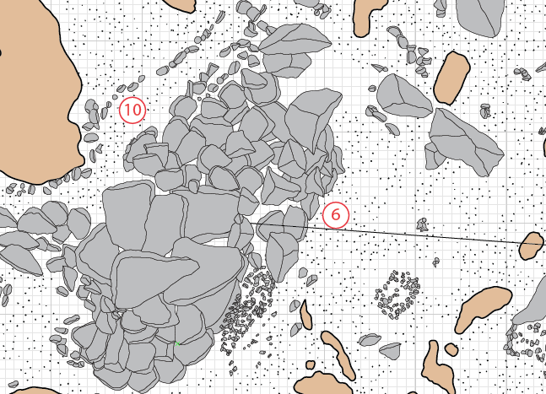
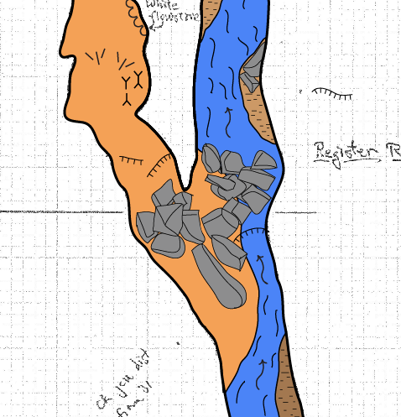
Rocks!
Done right, rocks with color can add a lot to a map. Nothing is easier to draw, and adds as much visual impact as rocks and other details

Slide 14
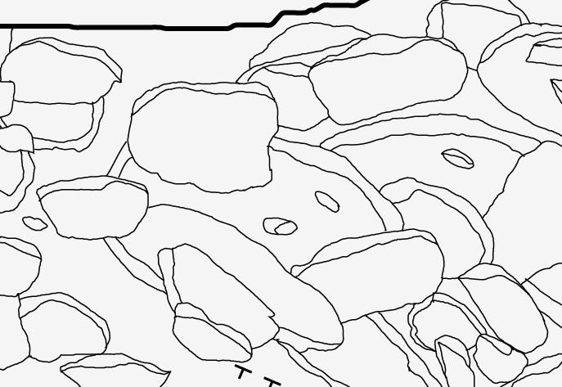
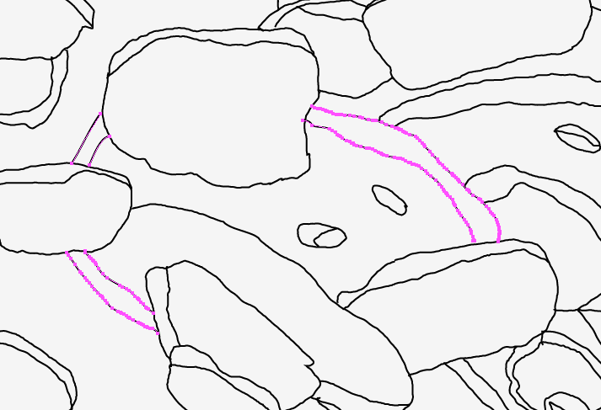
However using color with rocks forces us take special steps
Certain rocks that look good without color, like this large one, which is covered by other rocks….
is really made up of separate segments of line

Slide 15
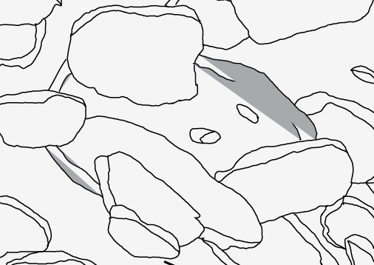
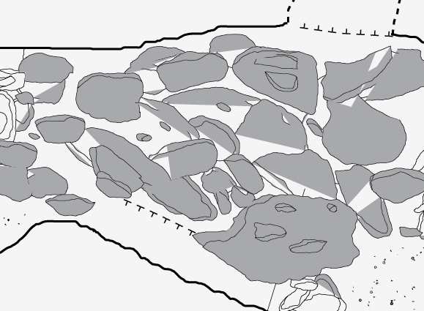
Trying to fill these ‘virtual’ rocks leads to disaster…..
In fact this issue is repeated many times in large rock piles

Slide 16
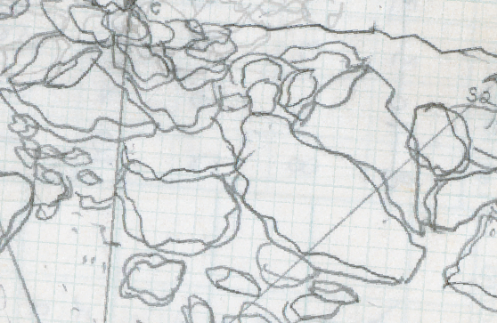
This is a result of a time saving (and necessary) technique of just sketching what you see in the cave, and not drawing the sections of rock you cannot see
We are not going to change the way we sketch rocks in the cave
..
But we ARE going to have to change how we represent them in our drawing programs

Slide 17
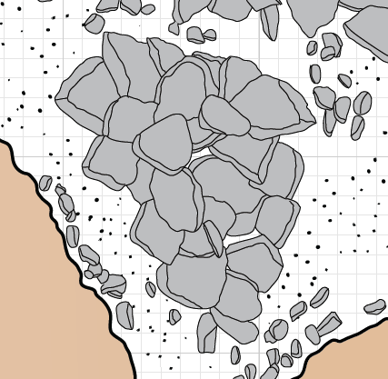
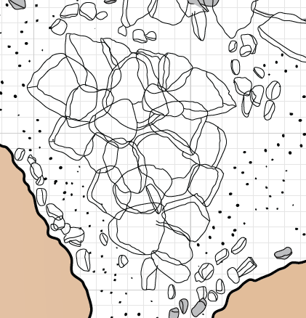
To make this work, most individual rock will have to be fully drawn and ‘closed
There are certain hints and tips to make this work better

Slide 18
1) Practice closing all your rocks:
Rocks need to be fully closed or ‘unslightly’ effects might occur. In some cases, color can ‘leak’ out of closed areas and flood adjacent areas
Shapes can be auto-closed, by holding down the alt key while drawing - this will force the shape to be closed

Slide 19
2) Watch your 3D effects
Some rocks need to be monitored to make sure that ‘3D effects’ do not break the fill.
The same thing that works in unfilled rock may not work in filled rocks
Sometimes the 3D effect needs to be an unfilled line to make sure that color does not bleed

Slide 20
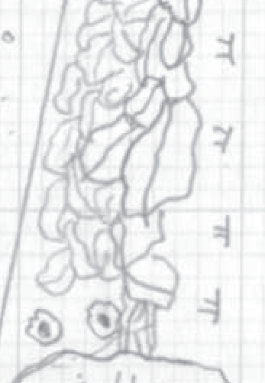
3) Plan Ahead!
When you have a pile of rocks, you are going to have to plan ahead to make them look natural.
Once you understand this it becomes easy

Slide 21
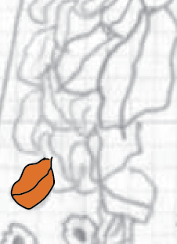
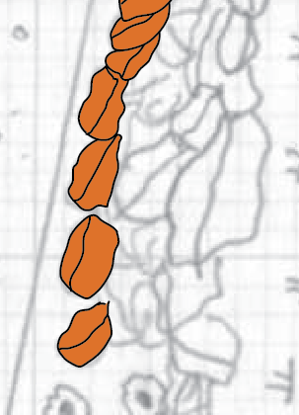
Start with your ‘deepest’ rock, the rock at the bottom of the pile. Draw it in and make sure it closes
Add your 3D effect. This can be hard, as the first shape (the one you drew in above) will cover your sketch. Work quickly to remember it, or just make it look good
Continue and complete all the ‘lowest’ rocks in the pile. These may be in a row, or randomly placed

Slide 22
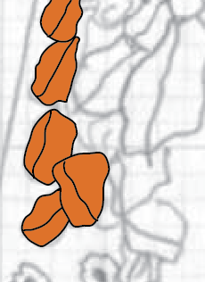
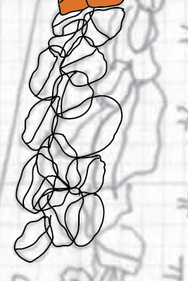
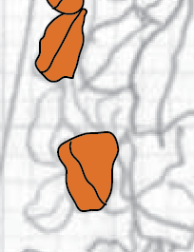
Start adding the second row up. Because the bottom row may cover some details from the second row, you may have to freehand, or try to remember…
I once tried to do this without fill, so I could see the sketch through the rocks, but this quickly grew to too many lines to make sense
You can also try turning rocks on and off in the Menu, but then you end up taking foever in the layers menu turning things on and off

Slide 23
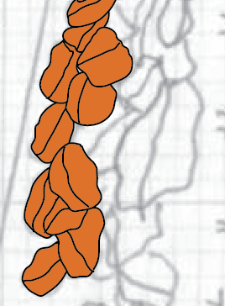
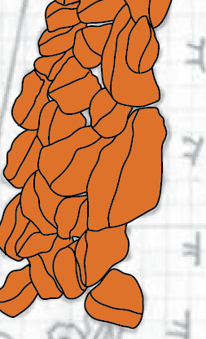
So keep adding more rocks, sometimes not strictly following the sketch, but making the arrangement true to the sprit of the sketch
Continue adding you are complete and you have a pile of rocks that creates the effect you want

Slide 24
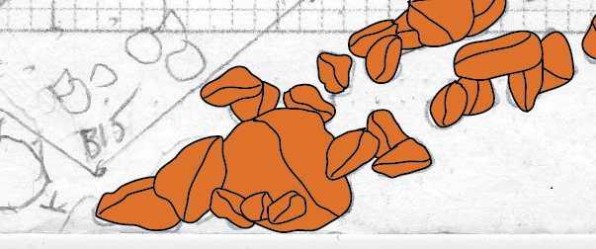
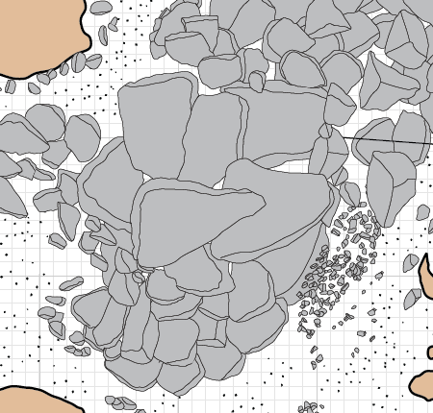
Many different looks are possible

Slide 25
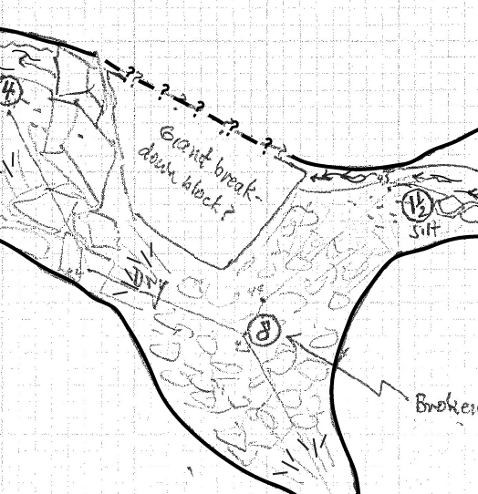
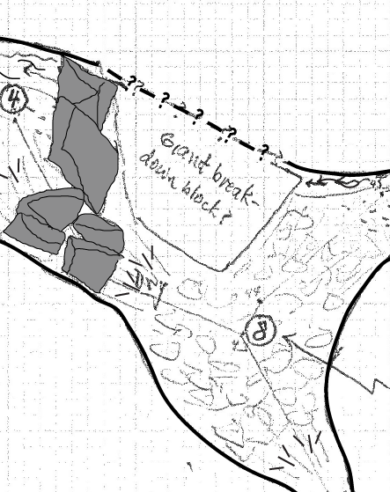
Large Breakdown rooms can be done fairly quickly as well – even if there is not a detailed sketch to work from
The original Sketch. Not much detail on the breakdown
Draw what is detailed

Slide 26
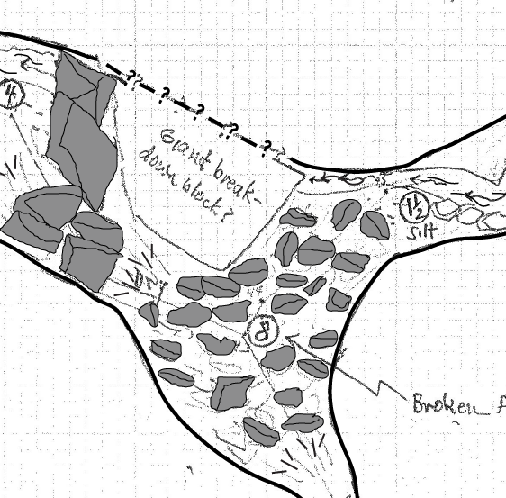
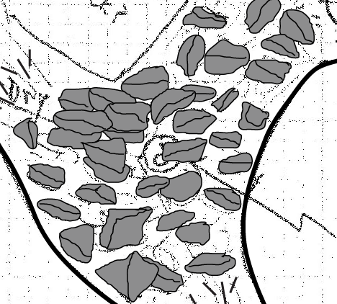
Add a widely distributed first layer
Start adding a second layer on top of the first

Slide 27
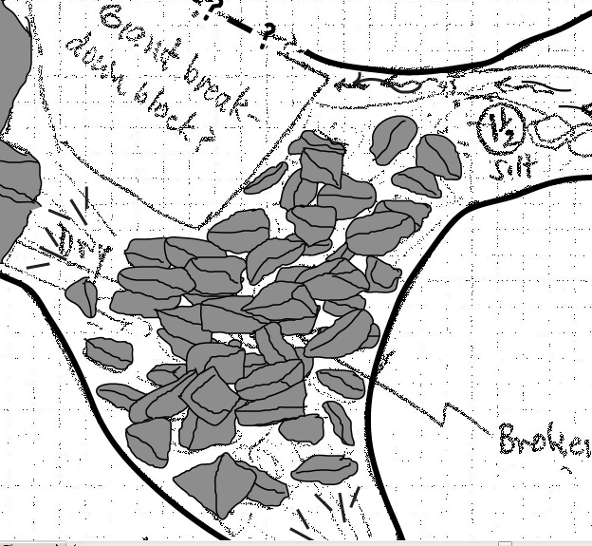
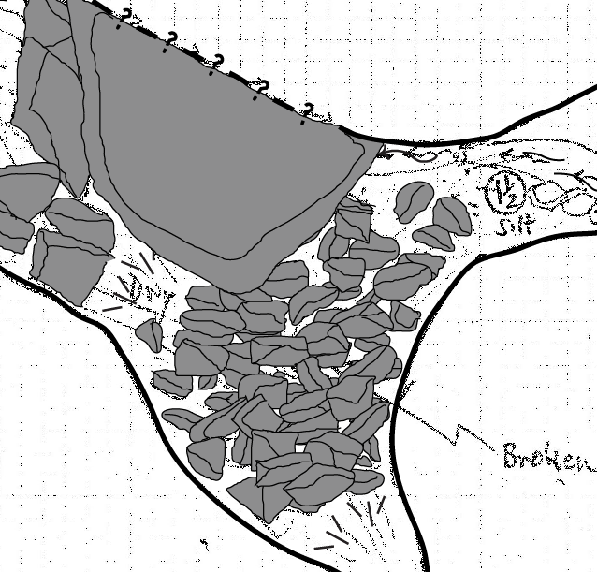
Continue adding the second layer, trying to cover as much floor as possible
Complete other Rocks and do final adds, again trying to cover as much white as possible

Slide 28
Finished rocks
Finished drawing, with other colors filling in blank areas

